Slide 1



VISION BUILDERS
LSBU Feedback Application System (FAS)
Enhancing Student Engagement & Teaching Quality​
Team Members’ Name:
Mahshid M. Z. Abadi 4401952
Alain De Jesus 4327230
Mythely Ganeshankugan 4503250
Shakshi Brijesh Patel 4428282
Edgar Camara 4434651
Alexandra Marcu 4420667
Professional Practice​ Module Code: CSI_4_PPR​
School of Engineering​ 2025/26 – Semester 2 – Date: 03 March 2026

Slide 2




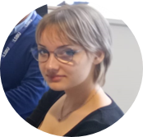

GANESHANKUGAN
Research Team
TEAM DYNAMICS
2
3
1
4
A . DE JESUS
UX Lead - Documentation - Presentation
6
5
M.M.Z. ABADI
Presentation Team
S.B. PATEL
Research Team
A . MARCU
Documentation Lead - Presentation
E . CAMARA
Technology Lead

Slide 3

PROBLEMS
SOLUTION
AIMS
OUR APPROACH
1. Lack of structured feedback loops.
2. Students feel unheard, instructors lack actionable insights.
3. Admins struggle to track satisfaction and engagement.
4. Instructors lack a platform to quickly feedback on student behaviour.
A fast, representative, anonymous Feedback Application System (FAS) that captures meaningful feedback after every session to enable timely, evidence-based improvements to teaching and learning.
Interview students (including UG/PG,
home, neurodivergent), teachers and admins:
1) Map current feedback journeys and pain points.
2) Craft personas
3) Mobile -first UX
4) Firebase cloud function to develop
Minimum Viable Product (MVP)
1. Teachers and student have actionable, role-based insights.
2. Provide admins with real-time analytics—all while protecting privacy.
3. Encourage continuous improvement.

Slide 4
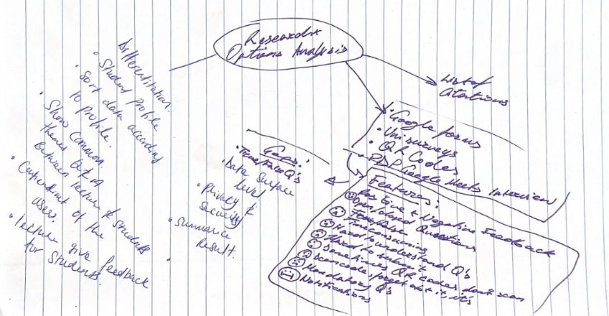
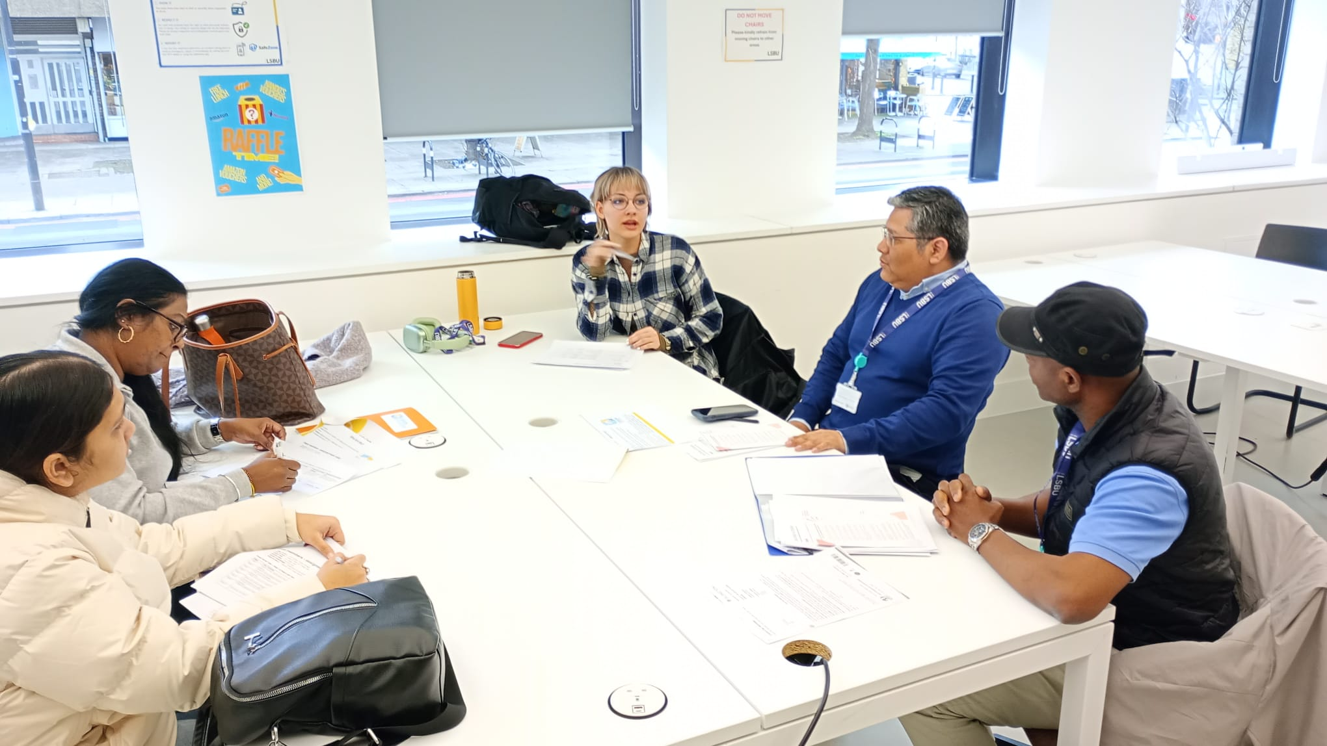
RESEARCH & OPTIONS ANALYSIS
Existing Solutions:
Time consuming
Mandatory Questions
Notifications
Gaps:
Privacy & Security
True/False questions
Surface-level data
Our Solution:
Common questions for the lecturer and student
The lecture gives students feedback

Slide 5

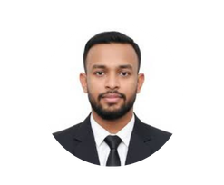
Role:
Year 2 BSc Adult Nursing student at LSBU.
Full-time student, working a part-time job.
Role:
10 years of experience in teaching maths and Computer Science at LSBU .
Fairy Jain
LSBU Student
Gary Carter
LSBU Lecturer
20 years old
Goal:​
Submit feedback quickly.​
Goal:​
Receive actionable
student feedback.​
Frustrations/challenges:​
Low response rate from students​
Needs/Preferences:​
Easy integration with Moodle.
Review student behaviour.
38 years old
Frustrations/challenges:​​
Feedback forms are long and repetitive.
Needs/Preferences:
The option to be anonymous.​
—SOMEONE FAMOUS

Slide 6
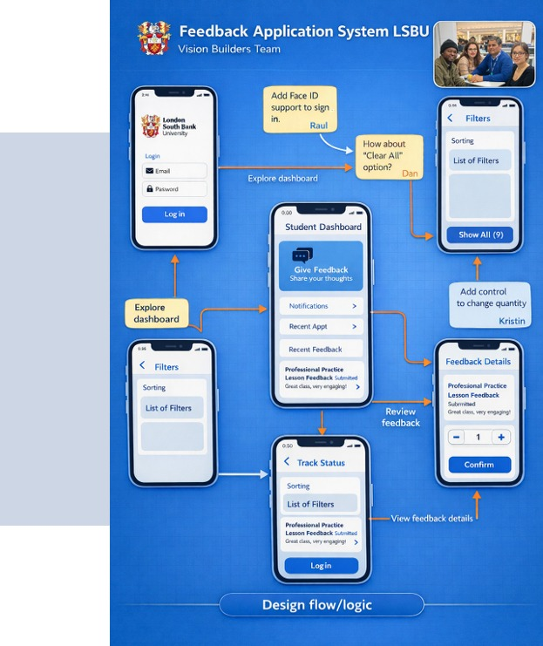






FRONTEND &
BACKEND SYSTEMS
Frontend
Next.js
TypeScript
Tailwind CSS
Mock-ups in Miro
Backend
NestJS
PostgreSQL
Redis
Audit logging
TypeScript: Fewer bugs mean fewer confusing moments for users, which builds trust in the platform.
Redis: Faster responses and rate limiting reduce spam and delays, which protects the student experience.

Slide 7
REFERENCES & CITATIONS
Slideshow:
Template by Slidesgo, icons by Flaticon, stock images by Freepik
Research & Options Analysis:
Existing solutions link
Gaps link
User Personas:
Student Photo via iStock / Lecturer photo via Instagram (AI
Student needs via TILE, ScienceDirect
Lecturer needs via DER monash, UCL

Slide 8

THANKS
Does anyone have any questions?

Slide 9


